Slide 1

Effective Curriculum Adaptation for SEND Children and Young People:
A Training for Teachers and Teacher Support Assistants
Dr Scott I-Patrick
Educational Psychologist

Slide 2

Training Goal
The goal of this training is to provide practical strategies that will enable teachers and teacher support assistants to plan and implement successful adaptations that meet the diverse needs of SEND students.

Slide 3
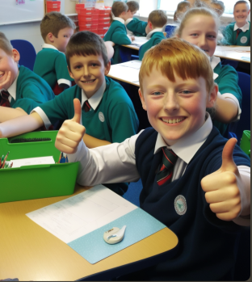
Training Objective
By the end of the training, you will have an improved understanding of effective curriculum adaptation for SEND children and young people and practical strategies for adapting the curriculum.
Notes:
The training will take place over one hour and will involve a combination of presentations, activities, and discussions.

Slide 4
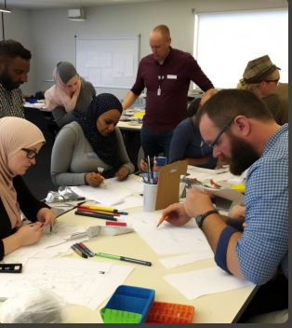
Training Aims
Assessing the current level of knowledge and skills of the teachers and teacher support assistants [5min group task]
Defining curriculum adaptation and its importance
High-quality teaching strategies for curriculum adaptation
Practical examples of successful adaptations
Tips to help teachers remember the difference between curriculum adaptation and differentiation and apply it when designing lesson plans
Forward planning, ongoing assessment, and feedback

Slide 5
Group Tasks
Activity 1
In your packs you will find paperclipped scenarios normally faced by teachers when planning curriculum content.
Sort each (paperclipped) scenario under the header of either …
adaption or differentiation
Activity 2
Take a look in the white envelope. You will find adapted lesson plans from teachers whose pupils have Autism, ADHD,EF challenges, Dyslexia and dyscalculia.
Sort each teachers plan into either …
adaptation or differentiation
Notes:
Fun task activities that can help teachers internalise the key differences between curriculum adaptation and differentiation
At the end of the task, lead a whole-group discussion to clarify any misunderstandings and reinforce the key differences between the two concepts.
This activity is not only interactive and engaging, but it also helps teachers to think critically and apply their understanding of curriculum adaptation and differentiation to real-life scenarios. Additionally, this activity promotes collaboration and communication among teachers, which can lead to the development of shared best practices for meeting the diverse needs of students in the classroom.

Slide 6
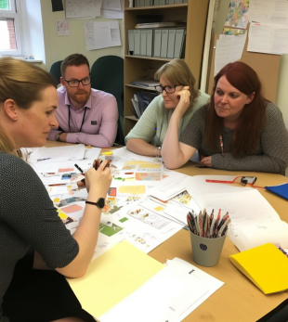
Defining Curriculum Adaptation
Curriculum adaptation involves modifying or changing the curriculum to meet the needs of learners with disabilities or other learning needs.
Effective curriculum adaptation is important because it can help ensure that all pupils have the opportunity to learn and succeed, regardless of their abilities or needs.

Slide 7

Comparison of curriculum adaptation and differentiation
Curriculum adaptation differs from differentiation, which involves modifying teaching methods or strategies to meet the needs of different learners.
While differentiation may involve adapting teaching strategies for groups of students, curriculum adaptation involves modifying the curriculum itself to better meet the needs of individual learners.

Slide 8

Challenges that teachers may face when implementing effective adaptations:
Teachers may face a range of challenges when implementing effective adaptations, including lack of time, resources, and training. They may also face challenges in identifying and addressing the specific needs of individual learners and ensuring that adaptations are appropriate and effective.

Slide 9
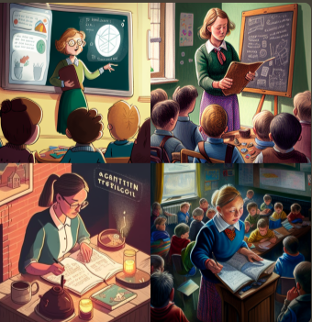
High-Quality Teaching Strategies for Curriculum Adaptation
Effective teaching strategies for curriculum adaptation can include modifications to content, instruction, or assessment.
Examples of modifications to content may include simplifying text, using real-life examples, or providing additional background information.
Modifications to instruction may involve adapting the pace, structure, or format of lessons to better meet the needs of learners.
Modifications to assessment may involve using alternative assessment methods, such as project-based assessments or oral assessments.

Slide 10
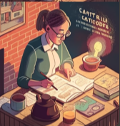
High-Quality Teaching Strategies for Curriculum Adaptation
Catering to different learning styles and abilities: It's important to cater to different learning styles and abilities when planning curriculum adaptations.
For example, visual aids such as diagrams, charts, or videos may be effective for learners who are visual learners, while hands-on activities may be effective for learners who are kinaesthetic learners.
Adaptations should also consider the strengths and weaknesses of individual learners and provide opportunities for them to develop their skills and abilities.

Slide 11

High-Quality Teaching Strategies for Curriculum Adaptation
Visual aids to illustrate the teaching strategies: Visual aids such as infographics or diagrams can be useful for illustrating the different teaching strategies for curriculum adaptation.
Using visual aids can also make the strategies more accessible and engaging for learners.

Slide 12
Group Task
Activity 1
In your packs you will find paperclipped scenarios normally faced by teachers when planning curriculum content.
Sort each (paperclipped) scenario under the header of either …
adaption or differentiation
Activity 2
Take a look in the white envelope. You will find adapted lesson plans from teachers whose pupils have Autism, ADHD,EF challenges, Dyslexia and dyscalculia.
Sort each teachers plan into either …
adaptation or differentiation

Slide 13
Practical Examples of Successful Adaptations
Practical examples of successful adaptations can include personalised learning plans, sensory activities, or the use of technology.
These adaptations are designed to meet the specific needs of individual learners and may involve modifications to content, instruction, or assessment.
Adaptations should be evidence-based and shown to be effective in supporting learners with disabilities or other learning needs.

Slide 14
Demonstrating Practical Examples of Successful Adaptations
Teachers should strive to demonstrate examples of successful adaptations in action, through videos or images of actual classroom adaptations.
This will help to provide a clear understanding of how adaptations can be implemented in practice.
Teachers and teacher support assistants to share their own examples of successful adaptations.
Sharing experiences and best practices can help build a supportive community of educators who are committed to providing the best possible learning experience for their pupils.

Slide 15
Additional examples of curriculum adaptation
Simplifying complex math problems for pupils with learning disabilities.
1
Modifying a reading assignment to be shorter and more manageable for pupils with attention issues.
2
Adjusting the level of difficulty for an art project to accommodate pupils with fine motor skill challenges.
3
Providing alternative assessment options for pupils with language barriers, such as allowing them to use visual aids or technology to demonstrate their understanding.
4
Modifying the seating arrangement or classroom environment to minimise distractions for pupils with sensory processing challenges.
5
Adapting a history lesson to be more culturally responsive and inclusive of all pupils' backgrounds and experiences.
6
Providing additional time and support for pupils who struggle with executive functioning skills, such as organising their materials or managing their time effectively.
7

Slide 16
Additional examples of curriculum differentiation
Offering advanced reading materials or extension activities for pupils who need a greater challenge.
1
Providing individualised coaching and feedback for pupils who need additional support to master a specific skill or concept.
2
Allowing pupils to choose from a variety of presentation formats (e.g., written, oral, visual) to demonstrate their understanding.
3
Offering opportunities for self-directed learning or inquiry-based projects for pupils who are highly motivated or independent.
4
Providing differentiated instruction in small groups or one-on-one settings to meet individual pupils needs.
5
Adjusting the pacing of instruction or providing additional breaks for pupils who struggle with attention or hyperactivity.
6
Offering opportunities for choice and autonomy in learning, such as allowing pupils to select their own topics or activities within a given framework.
7

Slide 17
Steps for Curriculum Adaptation and Differentiation in Lesson Planning
Identify
Identify the diverse needs and abilities of all pupils in the class.
Determine
Determine whether a particular need requires a change in the curriculum itself (curriculum adaptation) or a change in how the instruction is delivered or supported (differentiation).
Adapt
Adapt the curriculum or instruction based on the identified needs and abilities.
Assess
Continuously assess pupil progress and adjust the curriculum or instruction as needed to meet individual pupil needs.

Slide 18
I.D.E.A. for Curriculum Adaptation and Differentiation
I - Identify pupil needs and abilities
D - Determine whether to adapt the curriculum or differentiate instruction
E - Adapt the curriculum or instruction
A - Assess progress and adjust as needed
Notes:
By following these tips and the I.D.E.A. acronym, teachers can create inclusive and effective lesson plans that meet the diverse needs of all students in their classrooms.

Slide 19
Tips for Designing Effective Lesson Plans
Plan
Plan for both curriculum adaptation and differentiation from the beginning of the planning process.
Be
Be flexible and open to adjusting the curriculum and instruction based on pupil needs.
Use
Use a variety of instructional strategies and resources to meet diverse learning needs and styles.
Encourage
Encourage pupil input and involvement in the learning process to promote autonomy and engagement.
Collaborate
Collaborate with other teachers, specialists, and families to gather input and support for meeting individual pupil needs.

Slide 20
Forward Planning, Ongoing Assessment, and Feedback
Forward planning, ongoing assessment, and feedback are essential components of effective curriculum adaptation.
Forward planning involves anticipating the needs of learners and preparing appropriate adaptations ahead of time.
Ongoing assessment involves regularly evaluating the effectiveness of adaptations and adjusting them as needed.
Feedback involves providing learners with feedback on their progress and providing feedback to teachers on the effectiveness of adaptations.

Slide 21
Explanation of how to incorporate these into curriculum adaptation
Incorporating forward planning, ongoing assessment, and feedback into curriculum adaptation involves a cyclical process of planning, implementing, assessing, and adjusting adaptations.
Teachers should plan adaptations based on the needs of learners, implement them in the classroom, assess their effectiveness through ongoing assessment, and adjust them as needed based on feedback.

Slide 22
Tools and Techniques for Effective Planning, Assessment, and Feedback in Education
Tools or techniques that can support forward planning, ongoing assessment, and feedback include:
Personalised learning plans
Checklists for assessment
Technology tools for assessment and feedback (e.g. educational apps, online quizzes)
Collaborative planning and assessment with other teachers and teacher support assistants

Slide 23
Recap of the key points covered in the training
Throughout the training, we have covered the definition and importance of curriculum adaptation, high-quality teaching strategies, practical examples of successful adaptations, forward planning, ongoing assessment and feedback, and establishing a learning community
We have provided strategies, examples, and resources to support effective curriculum adaptation for SEND pupils

Slide 24
Encouragement to put the training into practice
Teachers and teacher support assistants are encouraged to put the training into practice and to use the strategies and resources provided to support effective curriculum adaptation
It is through practice and feedback that we can continue to improve and build on our skills and knowledge

Slide 25

Appreciation
Thank you for attending this training and for your commitment to providing effective curriculum adaptation for SEND pupils.
I appreciate your dedication to improving the learning and development outcomes of all pupils.
If you have any questions or feedback, please feel free to contact me through your SENCo, preferably via the termly virtual consultation sessions.

Slide 26

Exclusive Access to Doctoral Thesis
Request a Copy of My Doctoral Thesis Before Publication
As a thank you for your participation in today's training, I am offering delegates the opportunity to request a PDF copy of my doctoral thesis before its official publication.
The thesis is titled:
'What Can Children and Young People Tell Us About School Sanctions and Social Relationships: An Exploration of Exclusionary and Restorative Justice Practices’
If you are interested, please feel free to contact me at s.ighavongbe-patrick@buckinghamshire.com.

